Slide 1
TOPIC : Closures (with Scope and it's benefits)
PRESENTED BY:
SHARMEEN TARIQ
NAVEEN ASGHAR

Slide 2
Scopes:
Local Scope:
Local Scope occurs when you create a variable inside a function. By doing that, the visibility and accessibility of the variable is only allowed within that function.
Global scope:
Variables declared Globally (outside any function) have Global Scope.
Global variables can be accessed from anywhere in a JavaScript program.

Slide 3
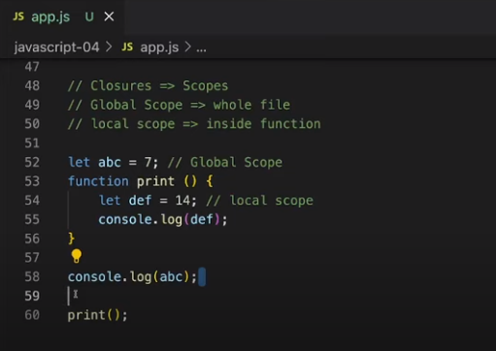
Result:7 and 14

Slide 4
Definition:
*A closure is the combination of a function bundled together (enclosed) with references to its surrounding state (the lexical environment). In otherwords: * A closure is a function having access to the parent scope, even after the parent function has closed. * JavaScript variables can belong to the local or global scope. Global variables can be made local (private) with closures.

Slide 5
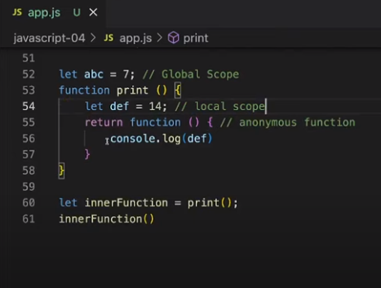
Slide Title
Result:14

Slide 6
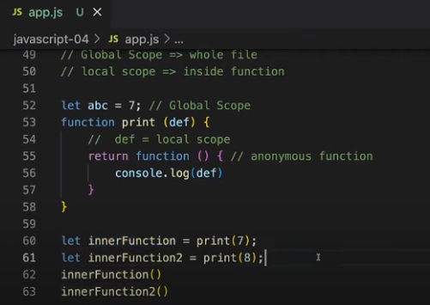
Result:
7 and 8

Slide 7
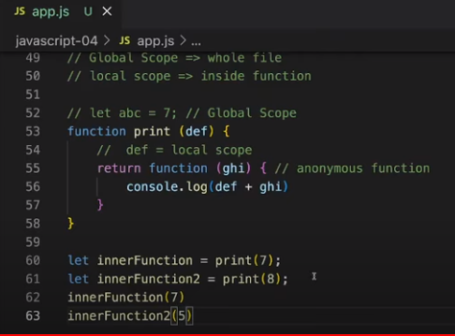
Result:
14 and 13

Slide 8
In simple terms, closures in JavaScript are used to:
- Keep certain variables and functions private and hidden from other parts of the code.
- Remember and access the values of variables even after the function that created them has finished running.
- Create reusable functions that can be customized with different values or behaviors.

Slide 9
Benefits of Closures
*Closures help in creating private variables and functions.
*Variables in the outer scope are hidden and inaccessible from outside.
*This enhances code organization, modularity, and security.
*Closures allow variables to retain their values even after the outer function finishes executing.

